Slide 1






Distributed Systems Project
Distributed
Sorting Algorithm
Prof. Hossam Mohamed Abdel Rahman
www.miuegypt.edu.eg

Slide 2

Distributed Systems Project
Introduction
  Massive data expansion renders single-machine sorting ineffective.
  Sorting is necessary for large data analytics, databases, and cloud systems.
  Our objective is to use Hadoop to accomplish distributed sorting effectively.
  Inspired by the notion of linked nodes working together as devices in a network to accomplish one purpose.

Slide 3


Distributed Systems Project
Problem Statement
  Traditional sorting algorithms struggle to scale beyond specific data sizes.
  High memory utilization and high processing times on a single machine.
  Need for a scalable, fault-tolerant, and parallel sorting solution.

Slide 4

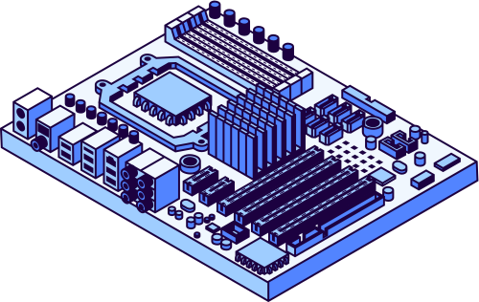
Distributed Systems Project
APPROACH
Local Sort
Each node sorts its own local data using a standard sorting algorithm (e.g., quicksort, mergesort).
Sampling & Partitioning
Nodes sample keys to estimate global data distribution and determine which partition

Slide 5
Distributed Systems Project
APPROACH
Data Shuffle (Exchange)
Data is redistributed across nodes so each node receives only records for its key range.
Final Merge
Each node merges or concatenates its received sorted data — the global dataset is now sorted.

Slide 6


Distributed Systems Project
Methodologies
Data Preparation
The dataset (numbers or text) is stored in the Hadoop Distributed File System (HDFS) and divided automatically into blocks distributed across nodes.
Map Phase
Each Mapper reads a block of data and outputs key-value pairs, where the key represents the value to be sorted and the value is null.

Slide 7


Distributed Systems Project
Methodologies
Shuffle and Sort Phase
Hadoop automatically groups and sorts all keys from different mappers in ascending order across the cluster.
Reduce Phase
Reducers merge the sorted intermediate data and write the final globally sorted output back to HDFS.

Slide 8
Distributed Systems Project
Methodologies
Testing and Validation
The final output is verified using sample and large datasets to ensure correct order, efficiency, and scalability.

Slide 9


Distributed Systems Project
Results
The System ran successfully in two modes:
Numeric and alphanumeric
Processed 5 million records effieciently using hadoop’s distributed framework
Job completed in under 40 seconds, confirming scalability.

Slide 10
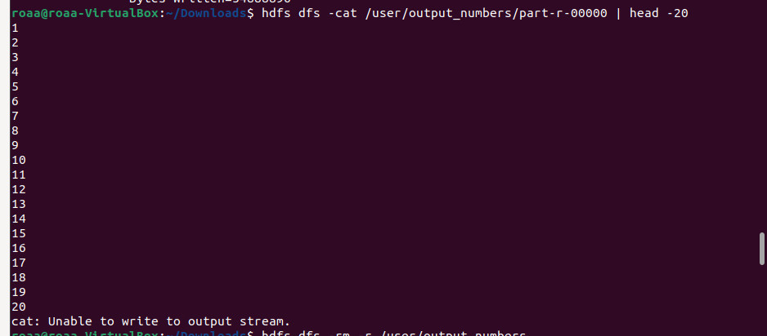
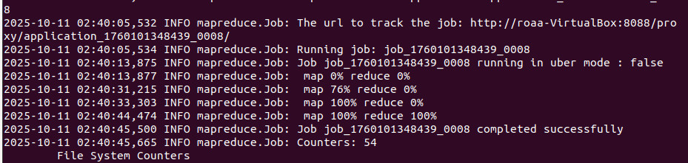
Distributed Systems Project
Numerical dataset

Slide 11
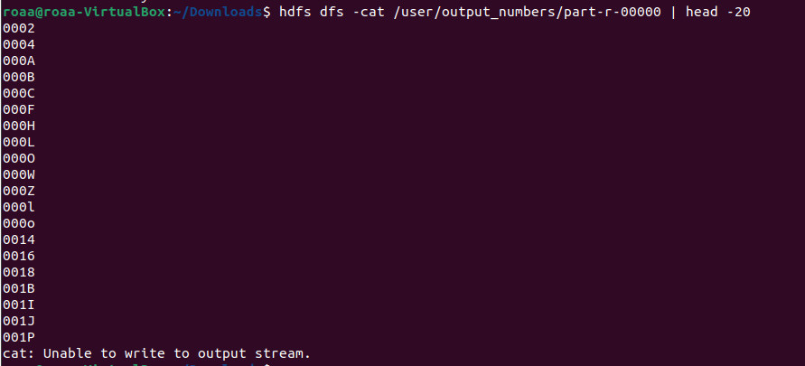
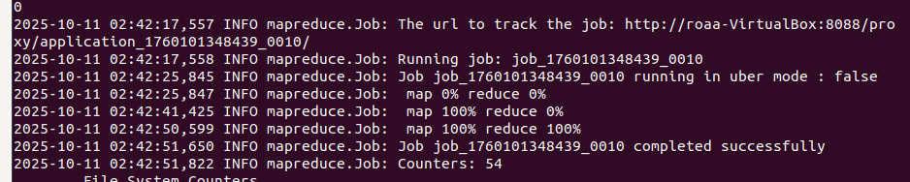
Distributed Systems Project
Alphanumeric dataset

Slide 12

Distributed Systems Project
Thank You!
Any Questions?
Presented by:
  Nouran Hassan Ahmed 2022/00062
  Yahia Tamer 2022/02264
  Malak Mohamed Abd-EL Razeq 2022/07005
  Roaa Khaled Salah 2022/05885

